Slide 1

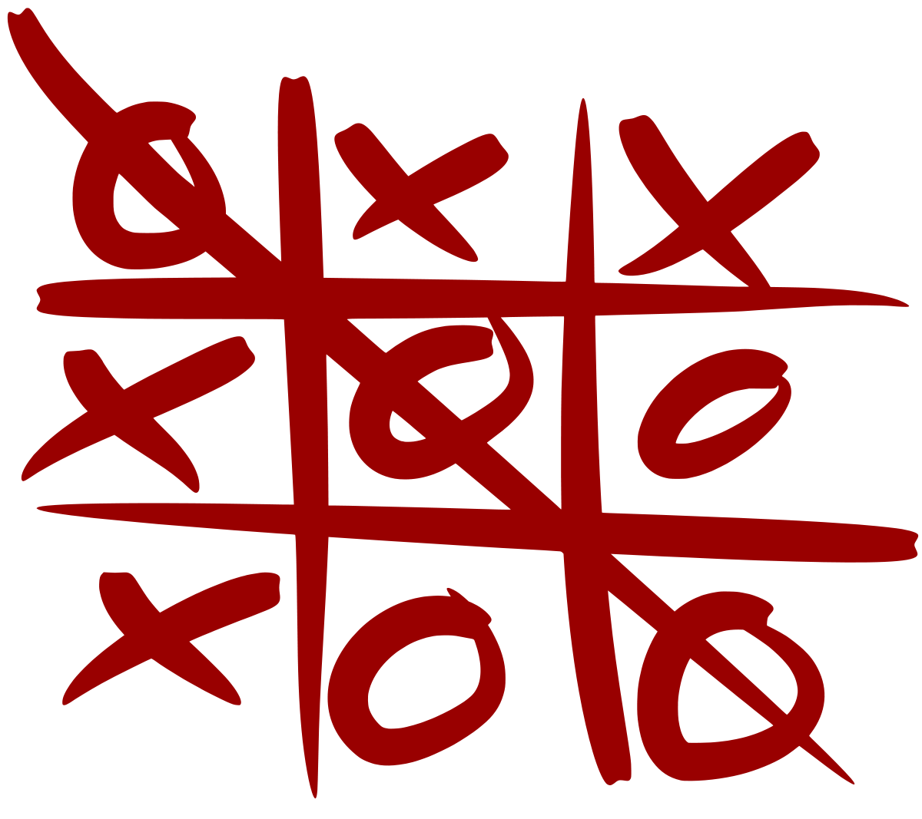
EC 3-In-A-Row
Group 8: The Logicians
Keven DeOliveira
Eric Cho
Harry Katsaros
Seifallah Ibrahim

Slide 2
Goal/Motivation
The goal of this project is to create a version of Tic Tac Toe that we named EC-3-In-A-Row
Tic Tac Toe is a timeless classic that we wanted to recreate due to its replayability and simplicity.
Obviously people play Tic Tac Toe daily, but with our design, they can now do it with style.
Notes:
KEVEN
~30 sec - 1 min

Slide 3
Functionality
EC-3-In-A-Row is a game designed to enhance players decision making and problem solving skills.
The two player game allows users to make a strategic decision of placing their designated mark on the 3x3 map displayed on the VGA.
Each player will have a binary representation of their unique mark.
The values are stored on the 3x3 map (9 registers), the goal is to have 3 of the same mark in a diagonal, vertical, or horizontal row.
Switches are used to denote whose turn it is, and which position they choose. An enable switch is used to confirm a player’s turn.
The RGB LED will light up accordingly based on winner
Red for Player 1, Blue for Player 2, Green for Tie
Notes:
KEVEN
Minute and half of talking:

Slide 4

Specifications
Constraints:
Only 9 possible positions
Occupied positions
Fixed player order
(player 1 always goes first)
Requirements:
Player vs Player
Easy way to choose desired position
VGA display of board
Display outcome of game
Notes:
HARRY
~1 minute

Slide 5
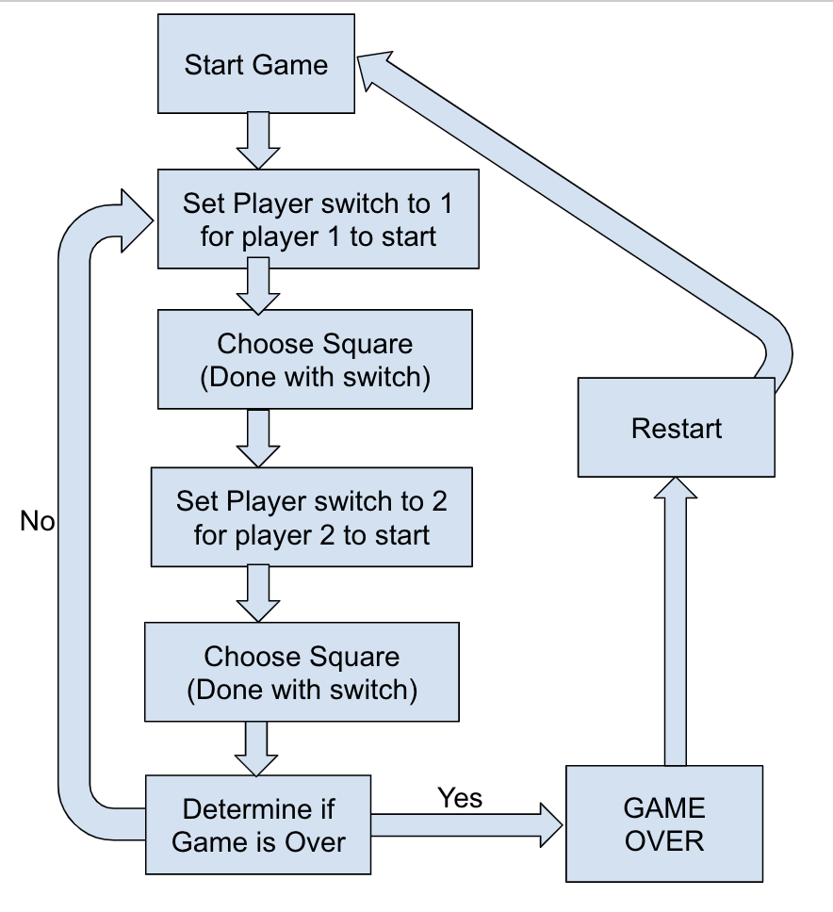
Gameflow Block
Diagram
Notes:
SEIF
2 minutes

Slide 6
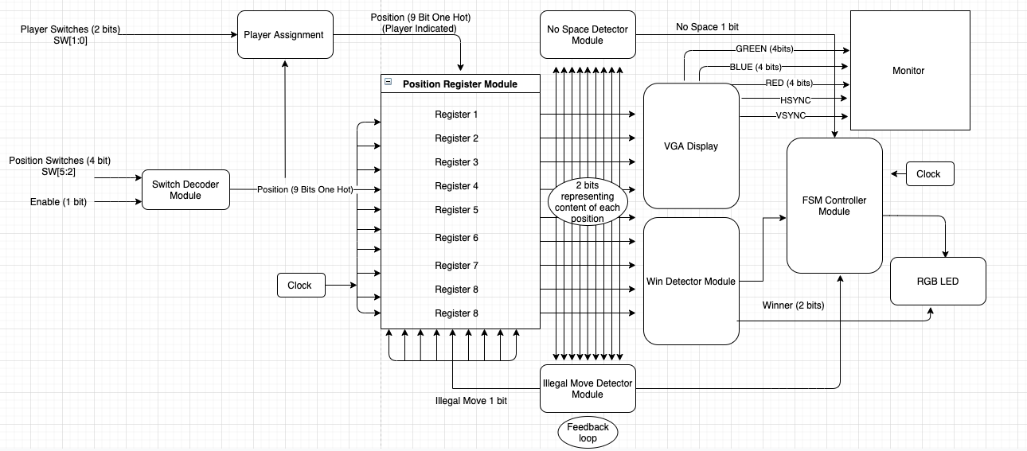
Module Diagram
Notes:
SEIF
3 minutes

Slide 7
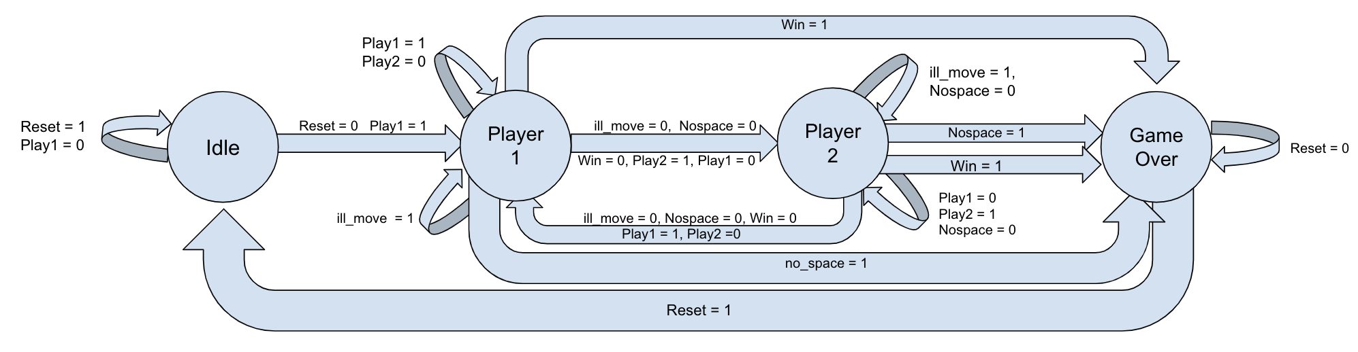
FSM
Notes:
ERIC
1.5 minutes
Remove play2=1 for transition from player 2 to game over. (player 2 doesn’t need to play for game to be over)

Slide 8
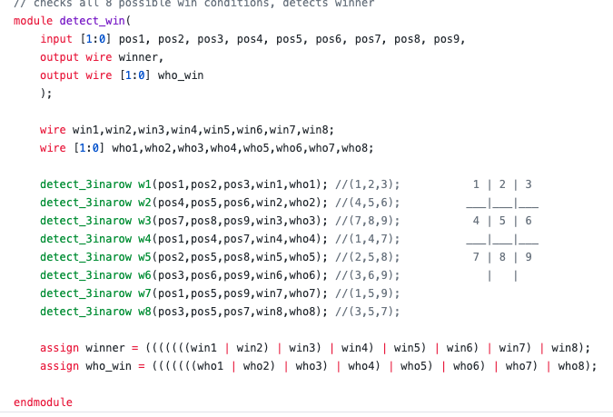
Code Snippet
Only 8 possible ways of winning
3 horizontal
3 vertical
2 diagonals
Calls on detect_3inarow for 8 configurations
Outputs
2-bit representation of the winning player
1-bit signal that there is a winner
Notes:
HARRY
1-2 minutes
Detect win: detects if registers in winning configurations are filled
Detect 3 in a row: detects if those positions are occupied by same player
Win1-8 is either a 0 or 1
Who win(2 bit) : 00 nobody
10 player 2
01 player 1
Inclusive ors at bottom to check if someone one

Slide 9
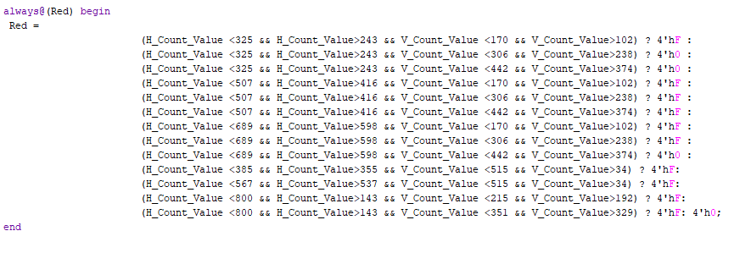
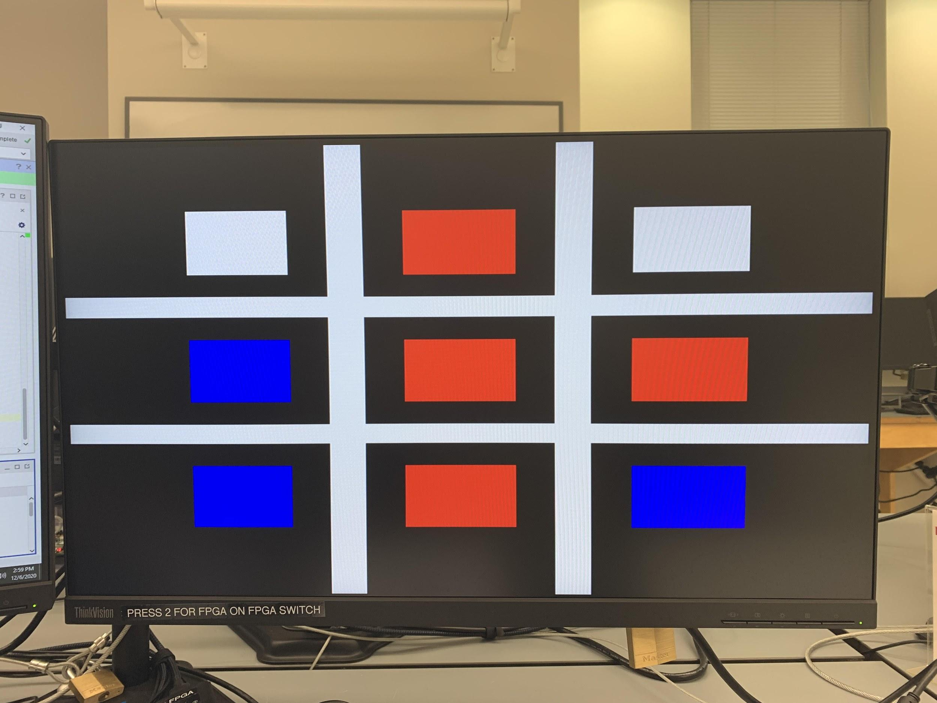
Code Snippet
1
4
7
2
5
8
3
6
9
Notes:
ERIC
1-2 minutes

Slide 10
Successes
Failures
As of 12/7/2020:
Switches accept user input.
Currently have a VGA controller that will do what we need.
RGB LED successfully denotes outcome of game.
Successfully can switch between turns and detect illegal turns.
As of 12/7/2020
VGA Controller still has to be hooked up to the rest of the logic.
The module has been created, but we still have to make a testbench and then implement it into our top module, then debug if necessary.
VGA display uses different colored squares but we wish to use graphics.
X’s and O’s, or maybe AND gates and OR gates if time permits
Notes:
ERIC
1 minute max

